Slide 1
TO WHAT EXTENT CAN MACHINE LEARNING BE APPLIED TO DAY TRADING
UG Final Year Project Interim Report
Intisar Haque150370413
SUPERVISOR: Paulo Oliva
December 2019

Slide 2
Aims and objectives
Are day traders warranted in their techniques?
Can this be automated?
Can a Machine Learning model perform better?
Create algorithms to represent day trading techniques
Match historical data to algorithms.
Machine Learning model to show patterns between techniques and market movement.
Calculate profit margin.

Slide 3
Why is this a computing problem
Thousands of hours spent every day by traders.
Different traders using different indicators.
Can a pattern be seen using these indicators?
How accurately could an individual combine multiple attributes?
Could this individual store the scores of different combination in memory?

Slide 4
Literature review discussion
Can specialists predict?
Can day traders predict?[1][3]
Technical Analysis
Financial Models
Candlesticks/Indicators [4][5]
Hybrid AI[6]
Neural Networks
Linear Regression

Slide 5
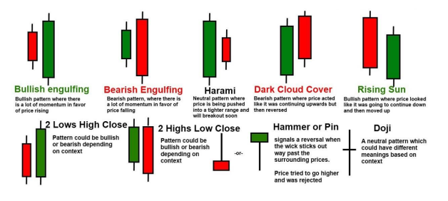
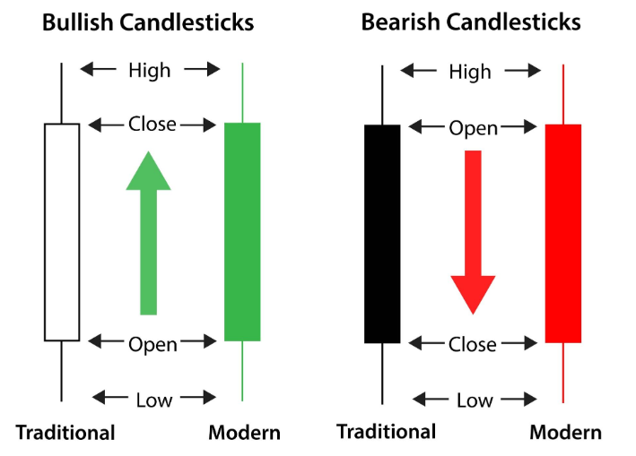
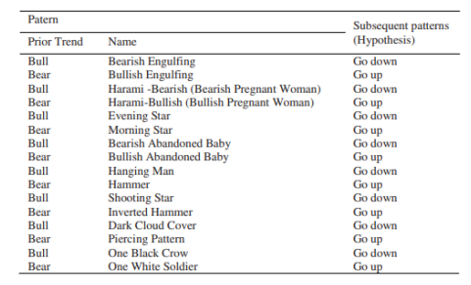
Candlesticks

Slide 6
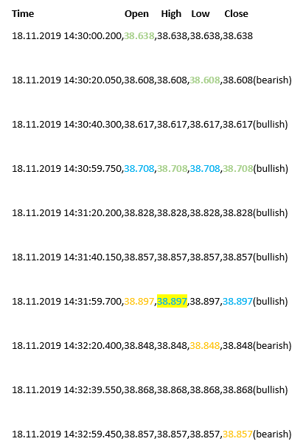
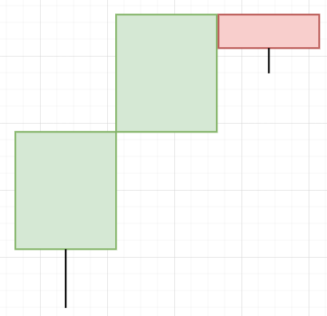
Example

Slide 7
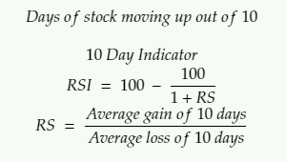
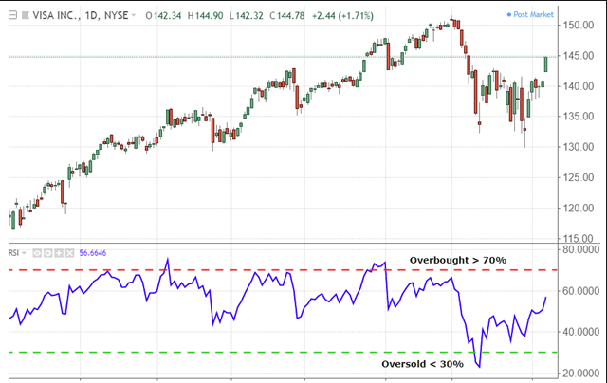
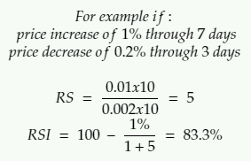
Relative Strength Index

Slide 8
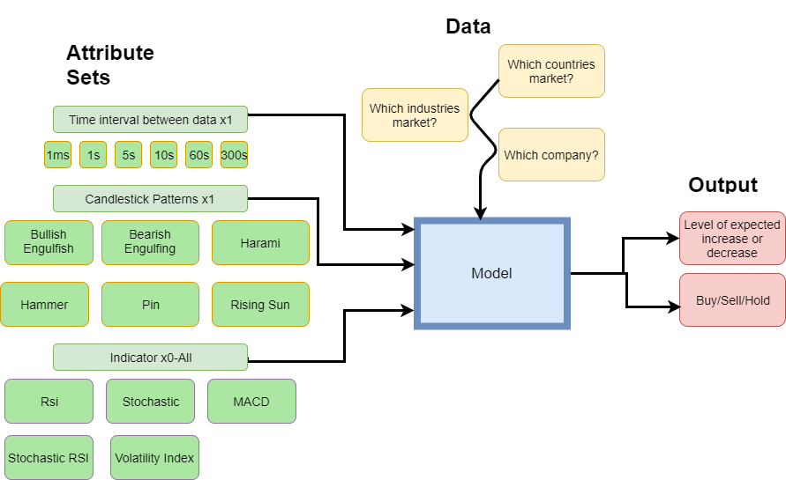
Proposed solution idea

Slide 9
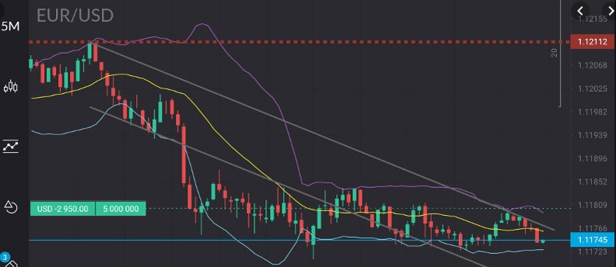
Visualised(Trading 212)

Slide 10
Evaluation technique
Historical data trading testing/validation
Live data trading
Loss of budget
Ethics
Profit
Fundamental Effects

Slide 11
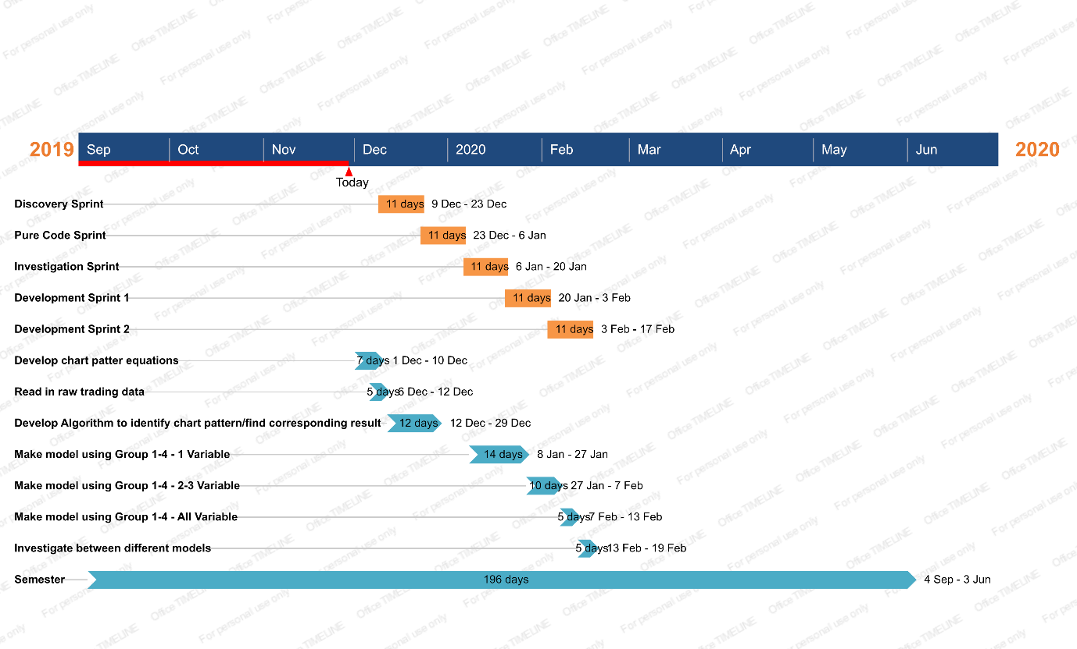
Project planning

Slide 12
Risk
Risk Description | Impact Description | Likelihood | Impact Rating | Preventative Actions
Budget Limitation | Limited on stock options: Certain model, certain stock | 0.5 | 9 | Cheap market
Latency | Delays caused by lag can mean a missed market | 0.3 | 6 | Internet Speed Latency
Market Access | No dataset No Trading API International Trading | 0.5 | 8 | Easy and legal market
Trading costs | Validation Errors plummet budget | 0.7 | 7 | Trading App More Capital
Model not definitive | Potentially no valid models | 0.8 | 9 | Extensive research to find various different chart patterns.

Slide 13
References
[1] Brown, S. (2018). Fake it till you make it: meet the wolves of Instagram. [online] The Guardian. Available at: https://www.theguardian.com/news/2018/apr/19/wolves-of-instagram-jordan-belmontsocial-media-traders [Accessed 29 Nov. 2019].
[2] Brokernotes (2018). THE MODERN TRADER. [online] Available at: https://brokernotes.co/wpcontent/uploads/2017/08/BN-research-report_2018-FINAL.pdf [Accessed 29 Nov. 2019].
[3] Prado, H., Ferneda, E., Morais, L., Luiz, A. and Matsura, E. (2013). On the Effectiveness of Candlestick Chart Analysis for the Brazilian Stock Market. Procedia Computer Science, 22, pp.1136- 1145.
[4] Otake, T. and Fallou, F. (2013). Can we apply Fibonacci retracement in the African market?. academicJournals, 7(24).
[5] Stock Members. (2019). RSI Indicator – I love it!. [online] Available at: https://www.stockmembers.com/rsi-indicator-i-love-it/ [Accessed 29 Nov. 2019].
[6]Yu, L., Leu, K. and Wang, S. (2005). Designing a hybrid AI system as a forex trading decision support tool. [online] Hong Kong: IEEE. Available at: https://ieeexplore.ieee.org/abstract/document/1562920 [Accessed 13 Dec. 2019].

